Slide 1

Movie Club Data

Slide 2

Agenda
Introduction
Club Rules
Project Overview
Our Data
Summary
My Thanks

Slide 3

Movie Club Society
We are three guys who love to watch movies. Once a week we pick a movie, watch a movie, and then talk and rate said movie. Lights, Camera, Action!

Slide 4
Our Rules:
- Movies cannot be longer than 2 hours and 15 minutes.
- Movies must be in English; we love foreign films, but sometimes we have other responsibilities and cannot read a whole movie.
- If it is the month of October, you must pick a horror film.
- If it is the month of December, you must pick a Christmas movie.
- If it is the month of your birthday, then you get to pick a bonus movie that can be any length of time, and the Club has the whole month to watch it.
- Even if you have seen the movie before you must watch it during that week period.
- You may never pick the all-girl Ghostbusters remake

Slide 5
Project overview
For the past three years Movie Club Society has been collecting data of our ratings and general information about the movies we pick. This project is a fun way for us to use this data to see some of our statistics.

Slide 6
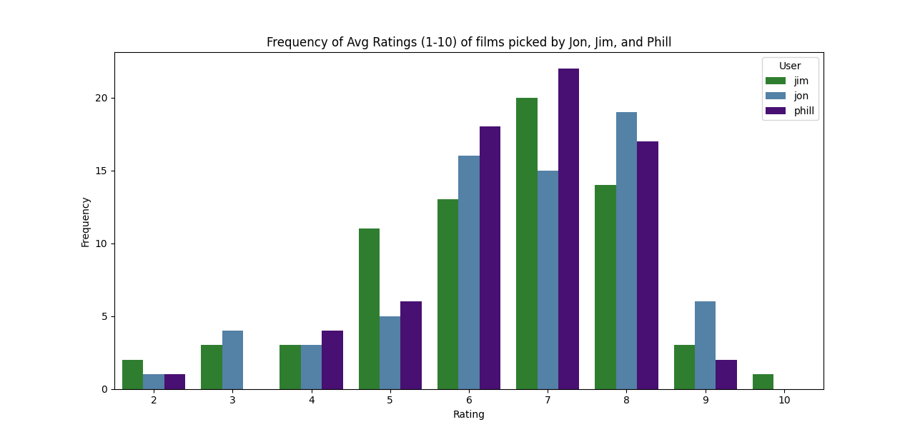
Figure 1

Slide 7
Figure 1 Above shows how often our picks get what ratings. If you notice Jim is the only one to have picked a movie that averaged out to a 10.
FIGURE 2 BELOW SHOWS A HEATMAP OF THE FREQUENCY OF OUR PICS. SAME DATA, DIFFERENT FORMAT.

Slide 8
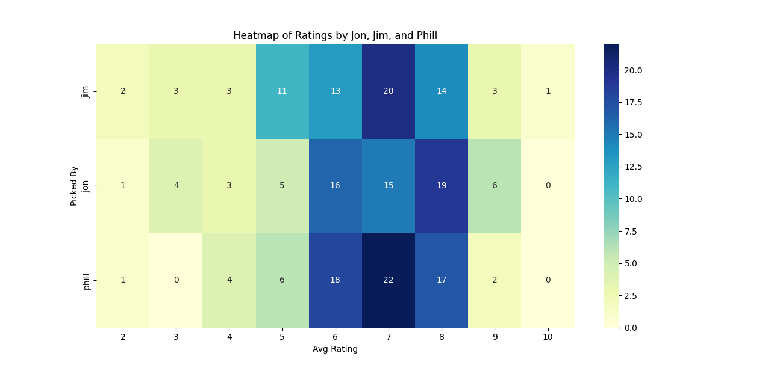
FIGURE 2

Slide 9
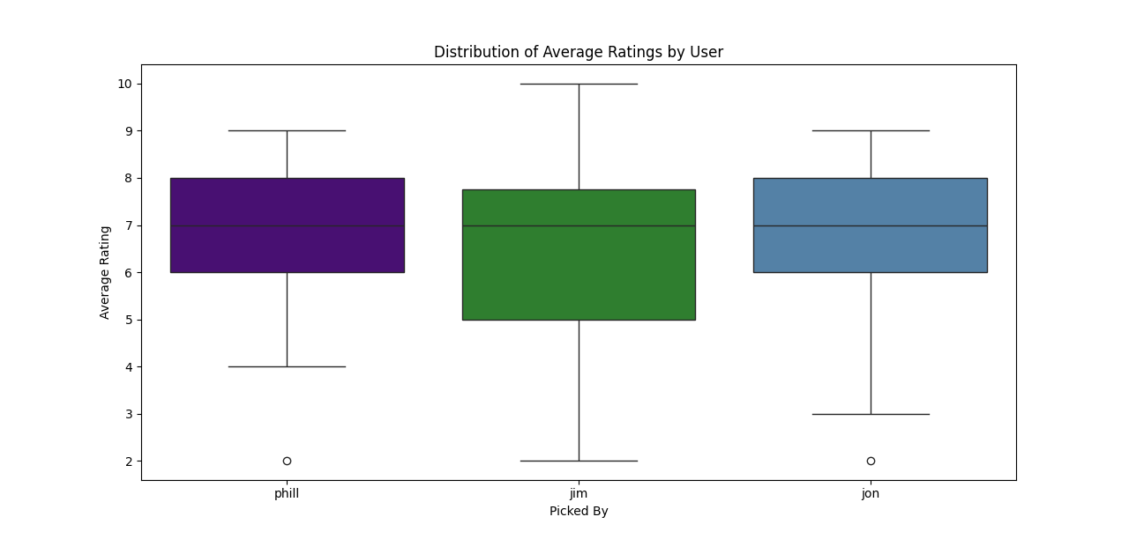
Figure 3 Shows our Pick Data with easy to see outliers

Slide 10
Figures 4,5,6: These Next three charts show a line chart for our three users (Jim, Jon, Phill) over time.

Slide 11
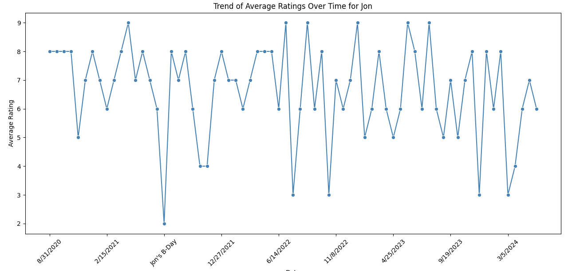

Slide 12
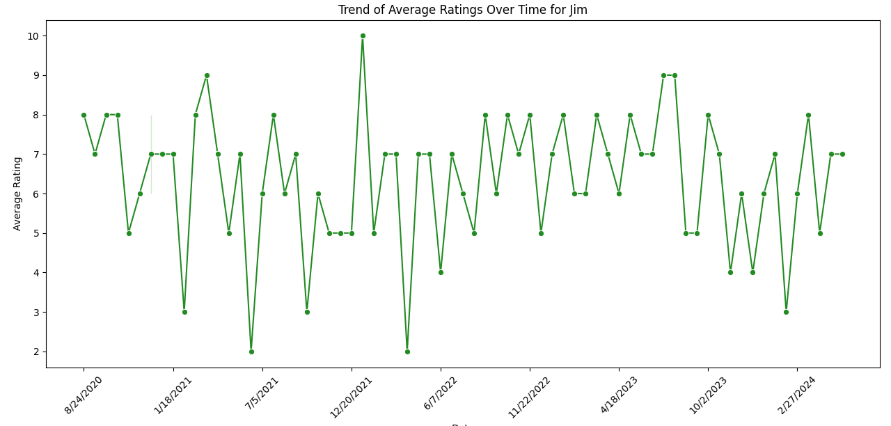

Slide 13
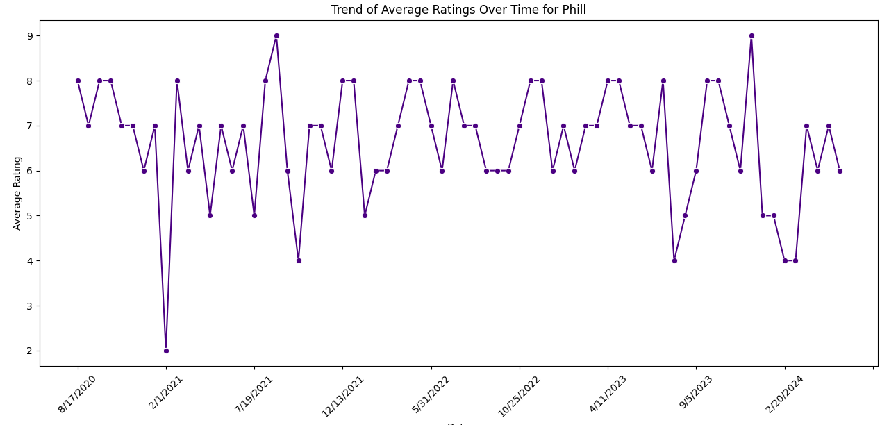

Slide 14
Figures 7,8,9: These Next three charts show a comparison to our pick averages and tmdb (The Movie Database)

Slide 15
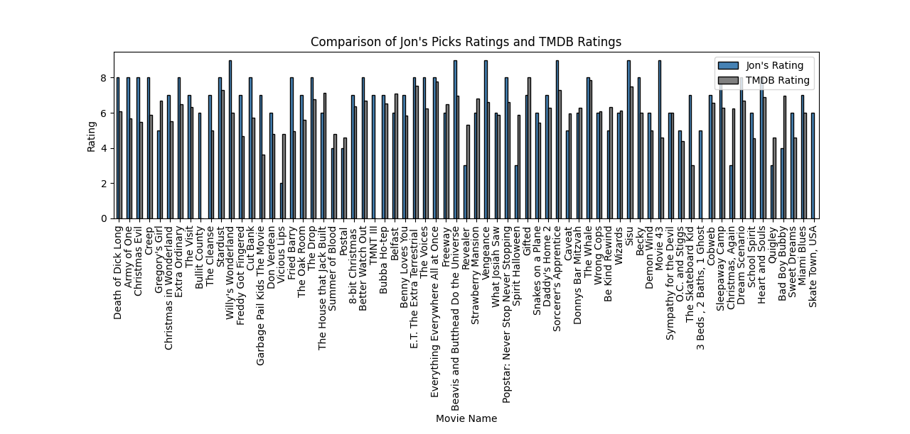

Slide 16
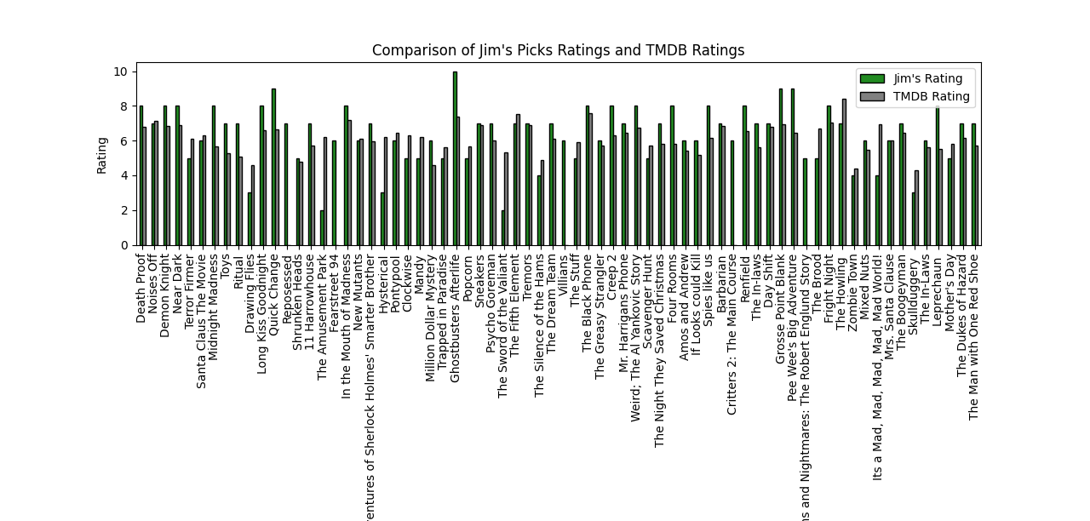

Slide 17
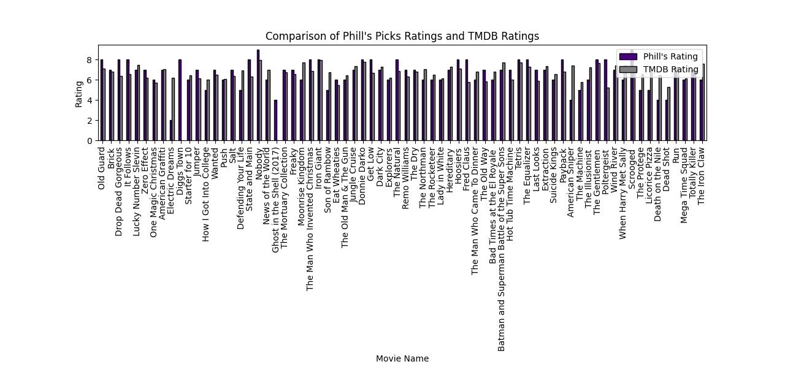

Slide 18
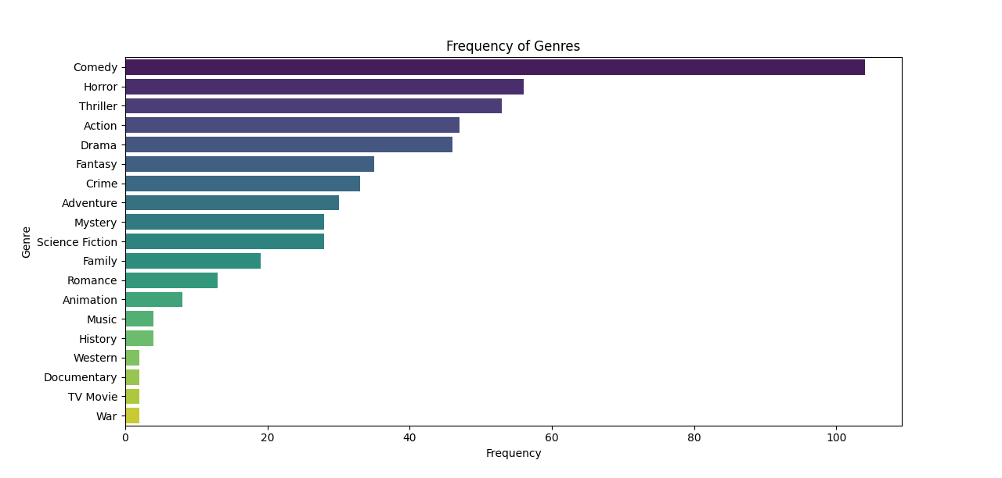
Figure 10 Show the Frequency of the genres we pick as a club

Slide 19
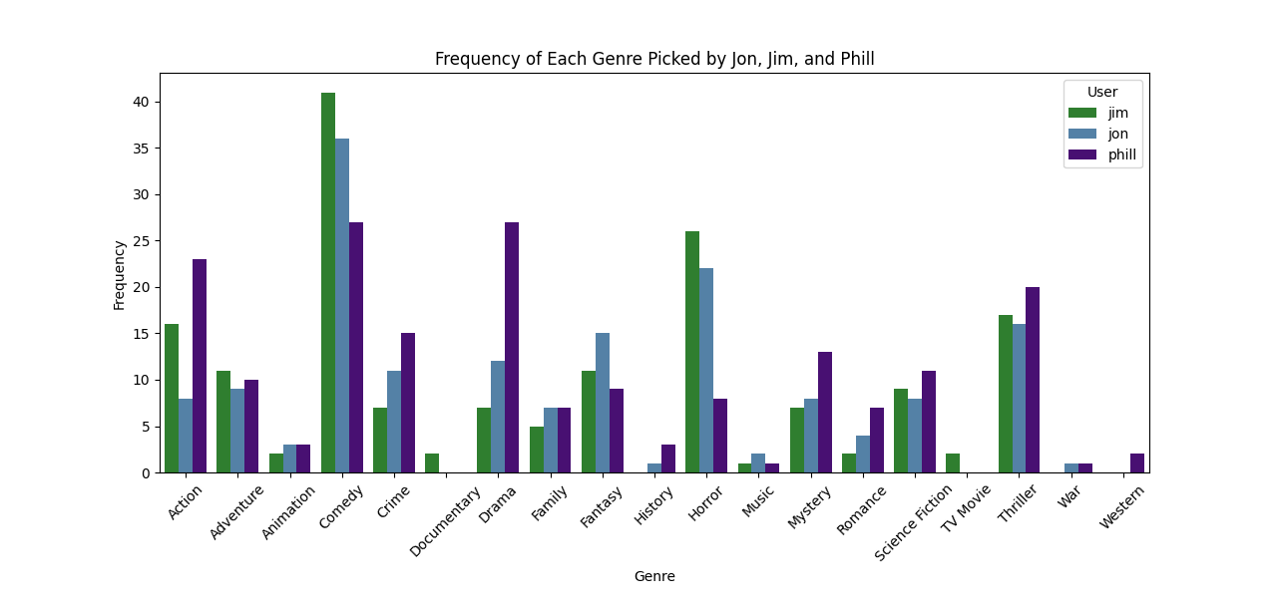
Figure 11 is Genre By User

Slide 20
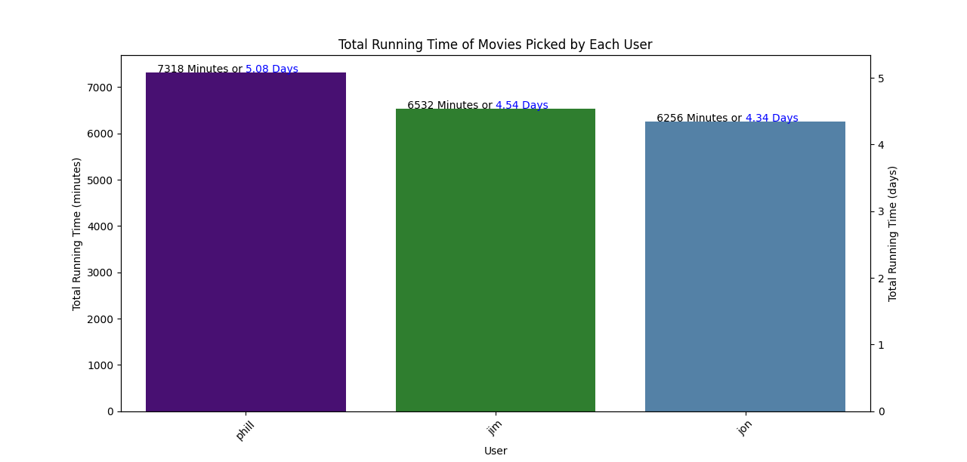
Figure 12 is a look at how long our picks were

Slide 21
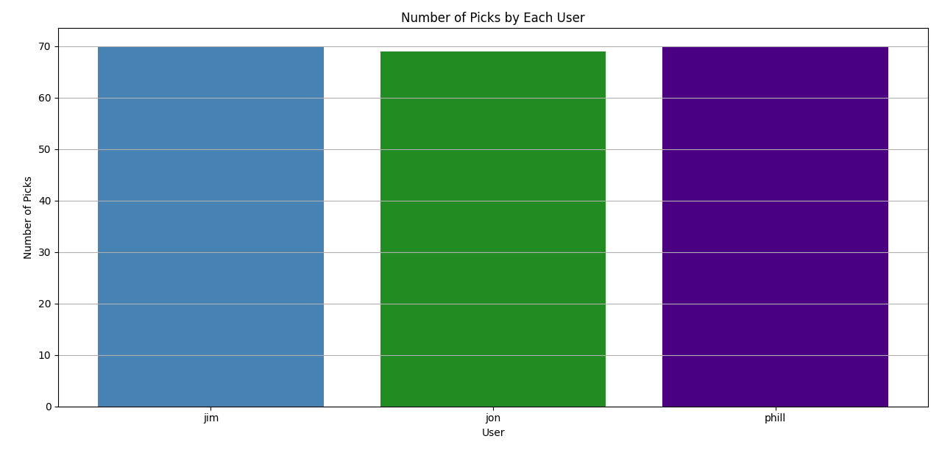
Figure 13. How many picks has each user done

Slide 22
Summary
Wow. That’s a lot of movies! This project has given Movie Club Society quite a bit of an overview on our data. It seems we love Comedy and Horror. It is obvious that Jim picks the best Movies. It looks like Phill Picks long movies, almost a full day longer than Jon. We seem to hand out a lot of Sevens. Thank you for taking the time to check out Movie Club Society’s movie data. That’s a wrap!

Slide 23

Thank you
I would like to take this time to thank my instructors at <Code>You. Their knowledge was invaluable. They were very great teachers. Also, a shout out to the <Code>You professional development team for all the help they gave regarding resume instruction and job searching. You guys are the best!
Jim Bundy
jameshbundy@gmail.com
gymbundye/github.com

